Slide 1
Adapting Existing Plans to Entice Today’s Evolving 55+ Buyers

Slide 2



John Thatch
Dahlin Group Architecture Planning
john.thatch@dahlingroup.com
Mary DeWalt
Mary DeWalt
Design Group
mary@marydewaltdesigngroup.com
Debra Bernard
The Bernard
Partnership
Dbernard@bernardpartnership.com

Slide 3
Session Description
The sum total of the nation’s home equity, a whopping $8 trillion, is in the hands of the 55+ homeowner making them a significant segment of home buyers. Overlooking their desires puts builders at risk of leaving opportunity on the table for someone else to grab, but today’s 55+ buyer is a dynamically evolving group and a growing number are not all that interested in age-restricted communities. There is a significant need to make sure for-sale homes can meet their evolving needs. Listen and watch our panel (home builder, architect, interior designer and marketing specialist) demonstrate how to revitalize existing floor plans of different densities (Single Family Detached, Townhomes and Flats), demonstrating innovative solutions for transforming conventional floor plans into versatile, timeless environments that allow homes to be functional and appealing in any market.

Slide 4
Session Learning Outcomes
Learn why and how to take a critical look at your plans and understand what they may be missing for your marketplace.
Discover the latest trends in living, kitchen, and baths that are key to aging-in-place principles.
Receive a checklist to assist in evaluating how well suited a design is to address 55+ buyer needs. Discover what it takes to attract the 55+ buyer to your community with age-in-place solutions.
Attendees will witness how they can adapt and refresh plans employing universal design elements to make them appealing to the 55+ buyer.

Slide 5

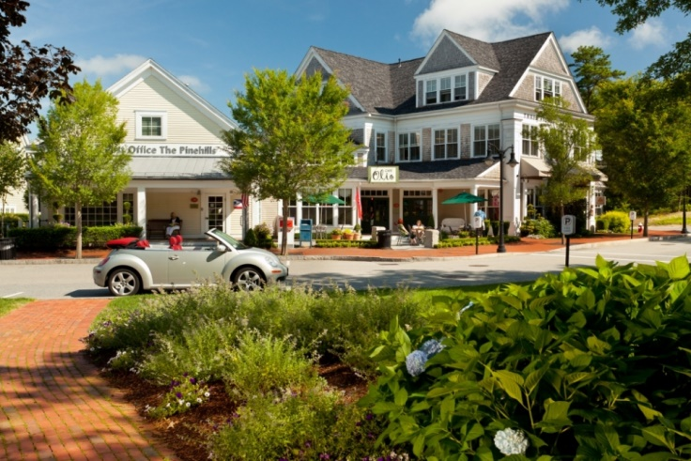
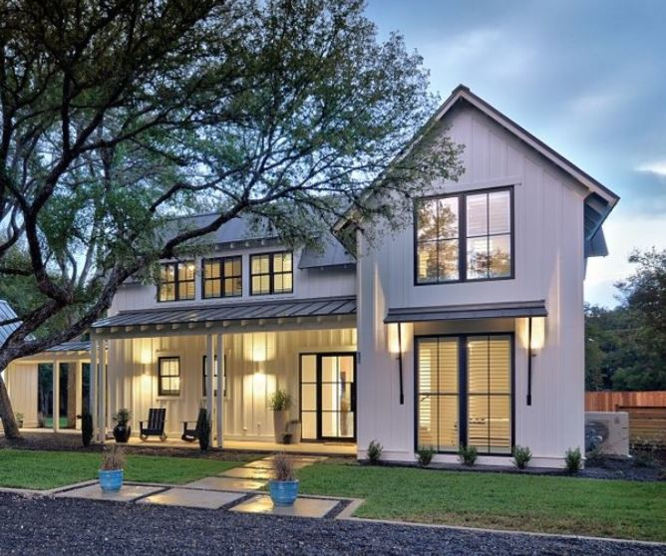
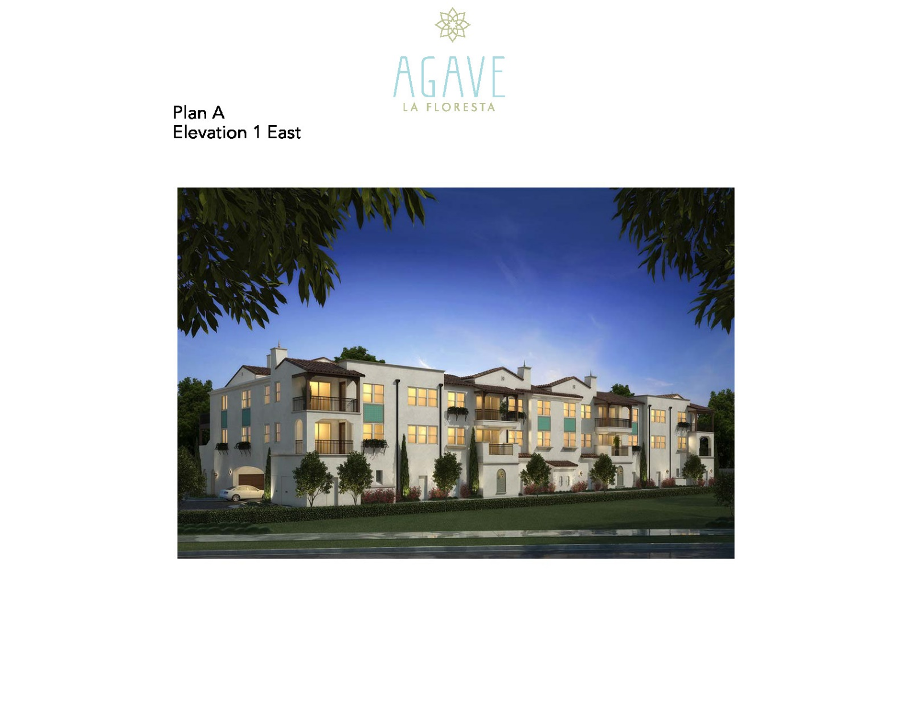
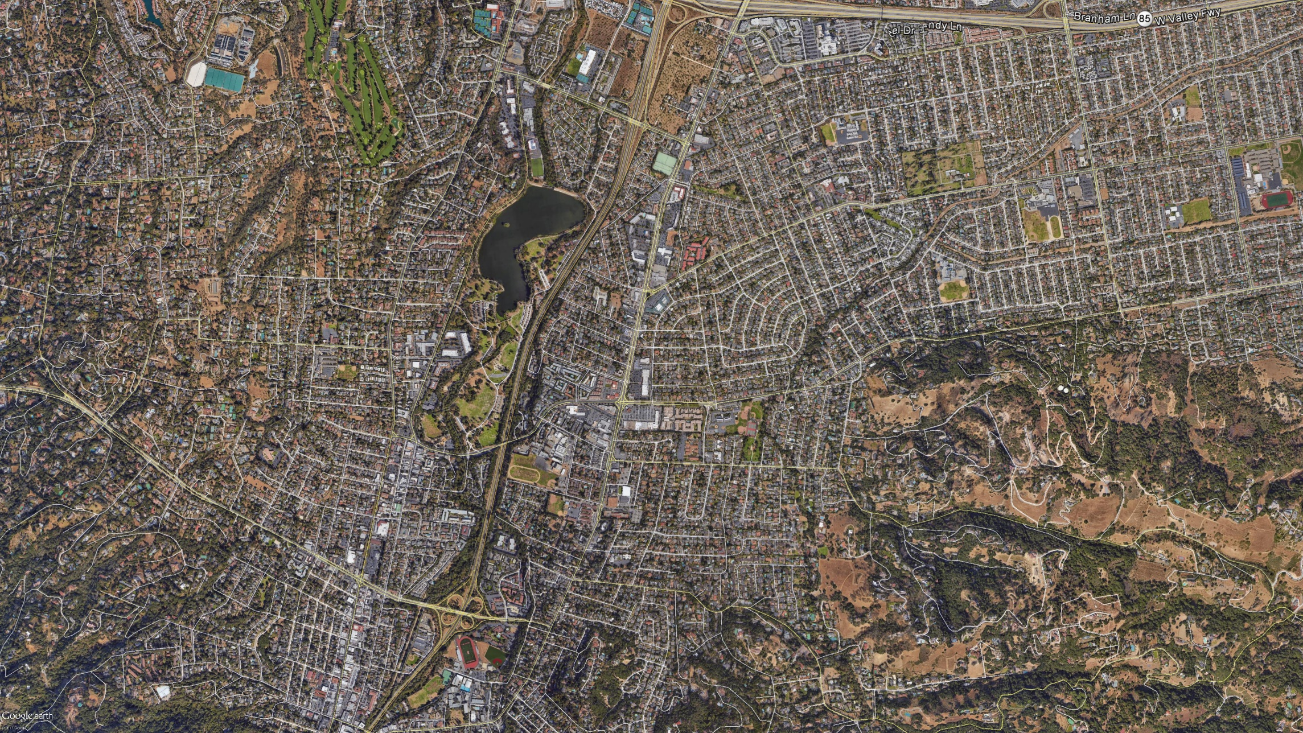
NOT THE SAME 55+ Active, Eclectic, Family
Second Home Market
MPC With a Twist
Enclaves With No Label
MPC With Clubhouse and Amenities
Urban Alternatives

Slide 7

American Institute of Architects (AIA)
Continuing Professional Education
Credit(s) earned on completion of this course will be reported to AIA CES for AIA members upon completion of the AIA/CES Session Participation Forms found in the back of this session room and online at BuildersShow.com. Certificates of Completion for both AIA members and non-AIA members are available upon request.
This course is registered with AIA CES for continuing professional education. As such, it does not include content that may be deemed or construed to be an approval or endorsement by the AIA of any material of construction or any method or manner of handling, using, distributing, or dealing in any material or product.

Slide 8


We are the 55+ Crowd
Defining what it means to get old, we are pioneers of a new paradigm

Slide 9
BABY BOOMERS – Pioneers Of A New Paradigm
In the 60’s, they created the youth movement, in the 70’s, the culture of excess, and in the 80’s, they were the “Yuppies”. Woodstock, the Vietnam War & John F. Kennedy’s assassination were all part of their youth
They are the first generation to envision a phased retirement of working longer, retiring later, and even working part-time in retirement – versus the old school “gold watch” retirement
They have driven lifestyle changes for decades, and are now turning retirement communities into places where they can keep the party going
Baby Boomers will be the architects of making this new paradigm a reality for generations to follow
Source: Transamerica Center for Retirement Studies

Slide 10
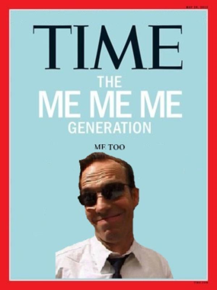
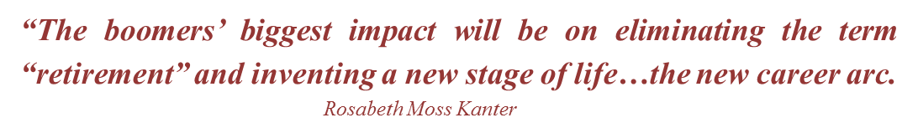
Attracting The Over 55 Market
The Over 55 consumer is more active and sophisticated than ever before and is looking for the NEXT ADVENTURE!
THE CONSUMER
Me too generation – belongers
The fiercely independent
Re-inventors

Slide 11


Boomer Needs Vary By Life Stage
55 to 65 years old = Active Adult
65 to 75 years old = Active Senior
75 to 85 years old = Restful Reflection
85 to 95 and beyond = Legacy Living

Slide 12



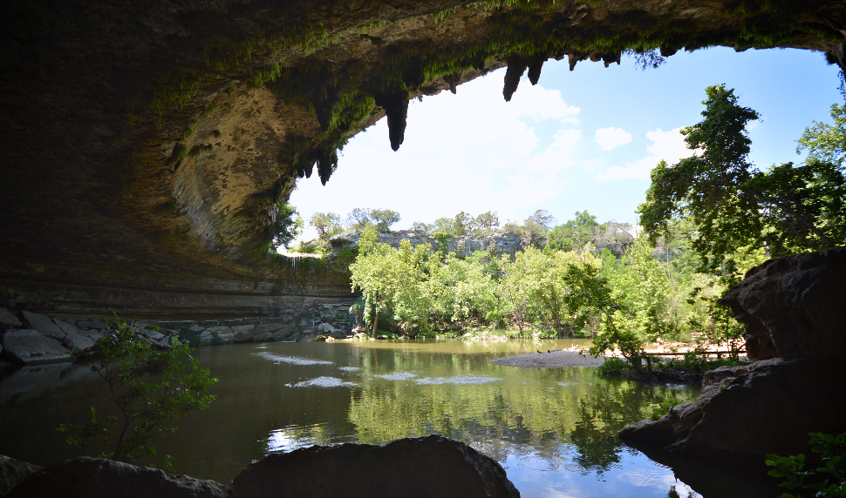

MERCHANDISING FOR TH
The Wellesly
Single person involved in the community
Lots of hobbies…gardening, art, travel
Carefree living - attracted to lock and leave lifestyle
Keep Austin Weird – mature and organized “Hippie”
Notes:
The oldest of the baby boomers went to Woodstock and the youngest voted for Reagan – very diverse and its important to embrace the diversity

Slide 13
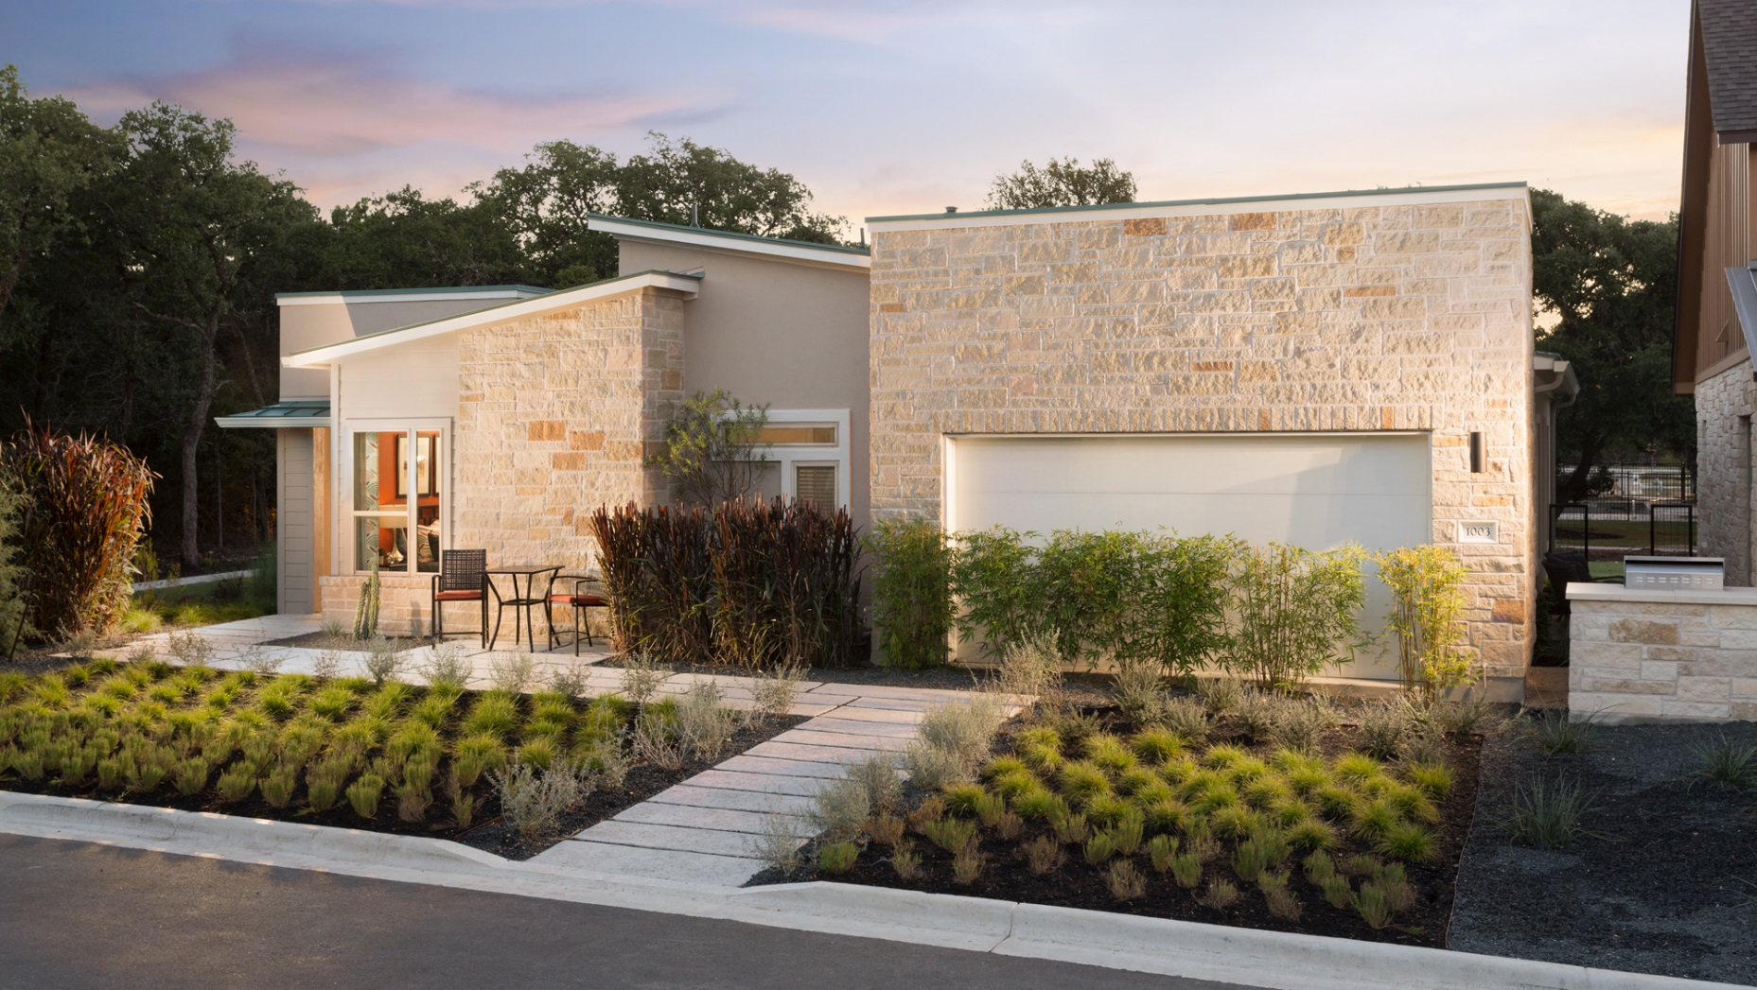
Notes:
Age preferred community with four distinctive architectural styles

Slide 14
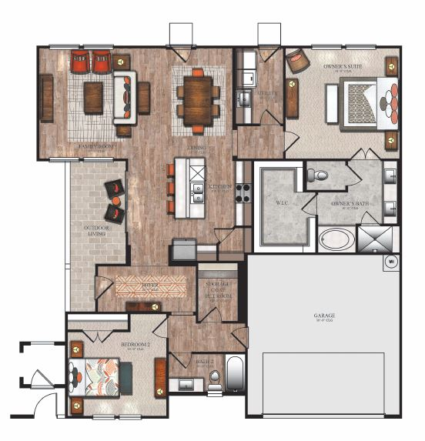
1,800 Sq. Ft.
Notes:
2 bedroom, open living, flex space for storage or doggie condo etc.

Slide 15
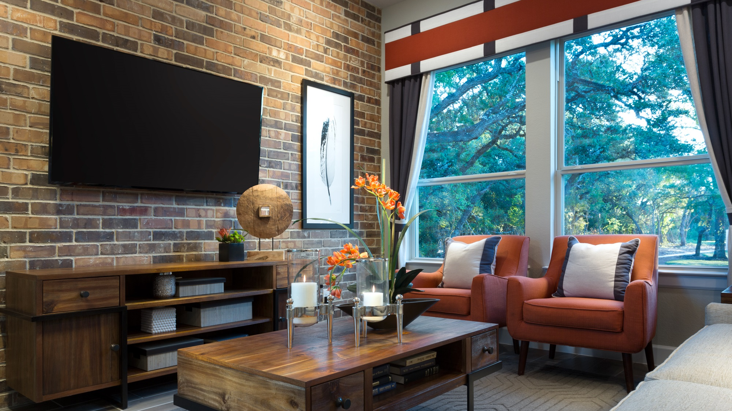
Notes:
Emotion is a large factor in the home buying market so reasonable upgrades are important to showcase

Slide 16
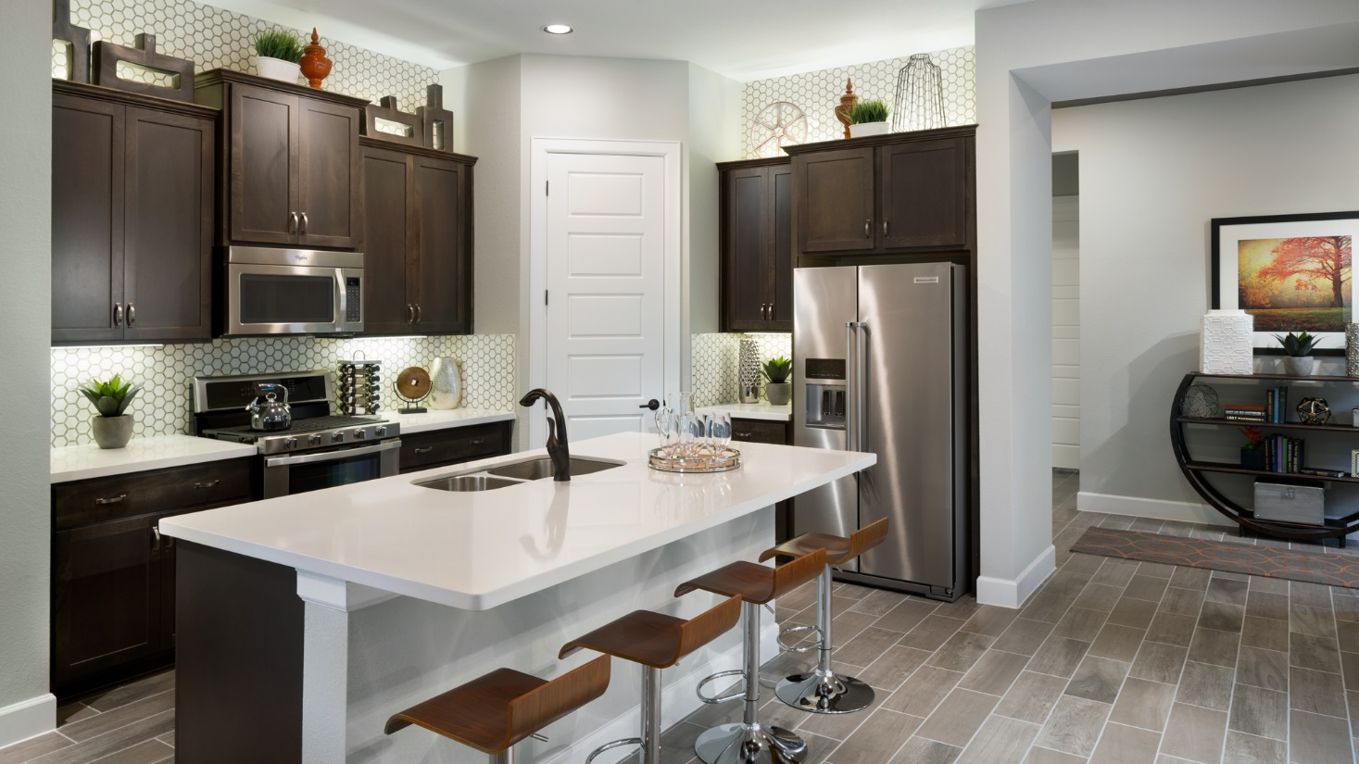
Notes:
“Tile” wood flooring – strong contrasts between white walls, counters and cabinets – very masculine

Slide 17
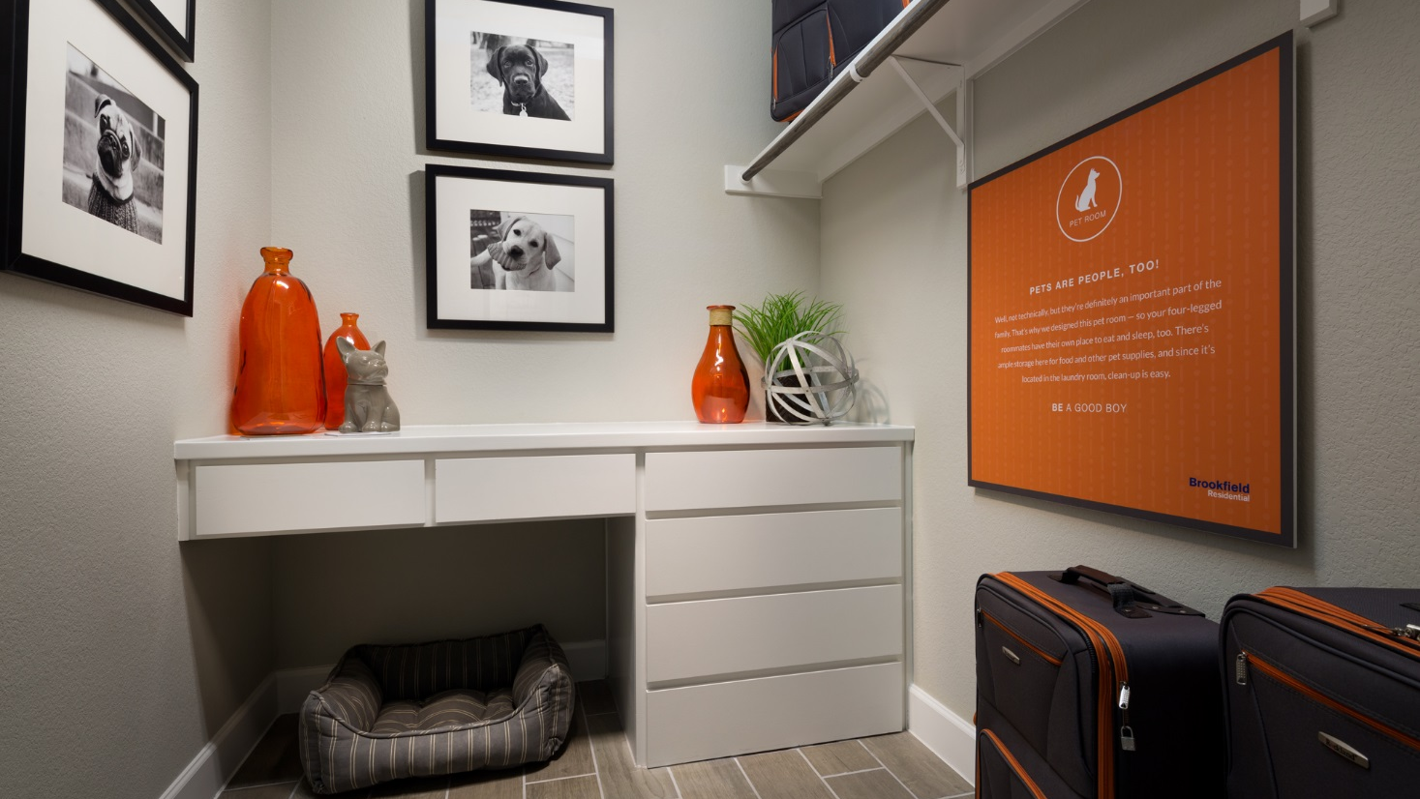
Notes:
Demonstating options –
‘art
Demonstrating options – “art” on right is a smile provoking narrative – Pets are People too!

Slide 18

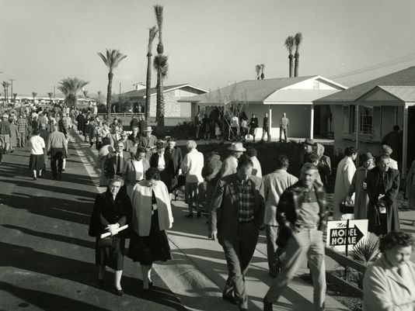
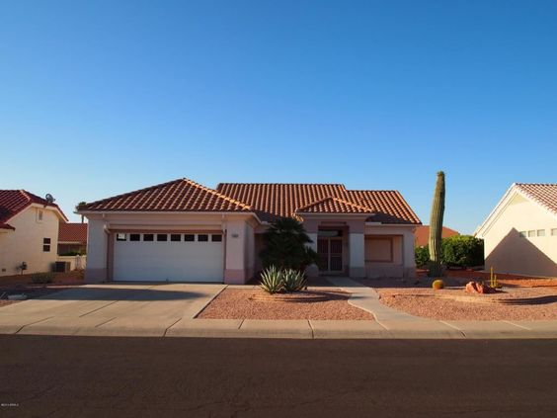
What Innovation Looked Like In The 1960’s
Del Webb – Sun City
The first major 55+ active adult community was Del Webb’s Sun City in Arizona
It all began with an idea to develop an entire community in the Southwest dedicated to a more leisurely lifestyle for the retired, active adult

Slide 19
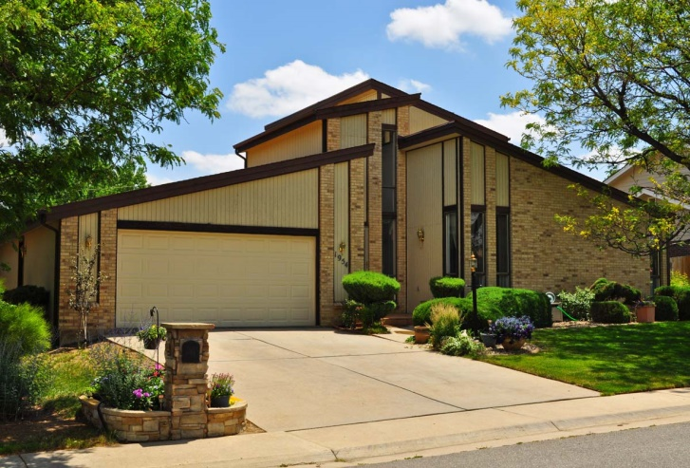
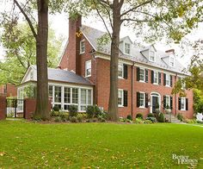
What Innovation Looked Like In The 1970’s
By the 1970’s, single-family homes grew to an average finished area of 1634 SF (a 66% increase from the 1950’s)
65% of homes now had at least 3 bedrooms and 23% had 4 bedrooms
Exterior designs were still principally brick and wood (70%)

Slide 20
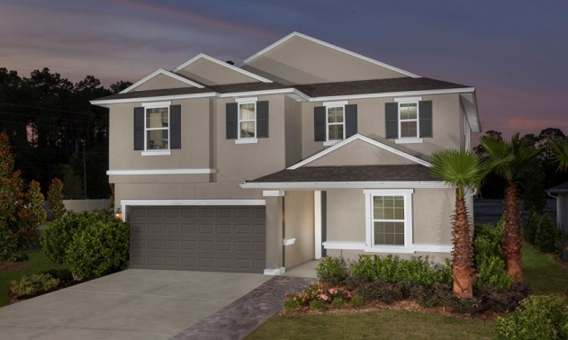
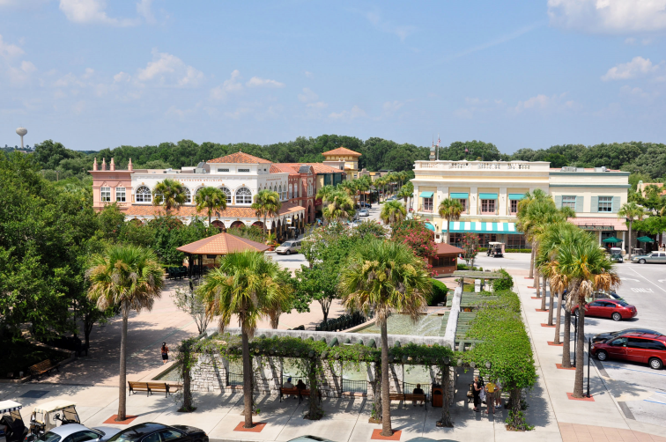
What Innovation Looked Like In The 1980’s
KB Home production housing
The Villages – founded 1980’s
“Create a warm, secure and friendly hometown.” At the heart of the community lies three old-fashioned town squares with plenty of modern day fun
Florida retirement – golden girls

Slide 21

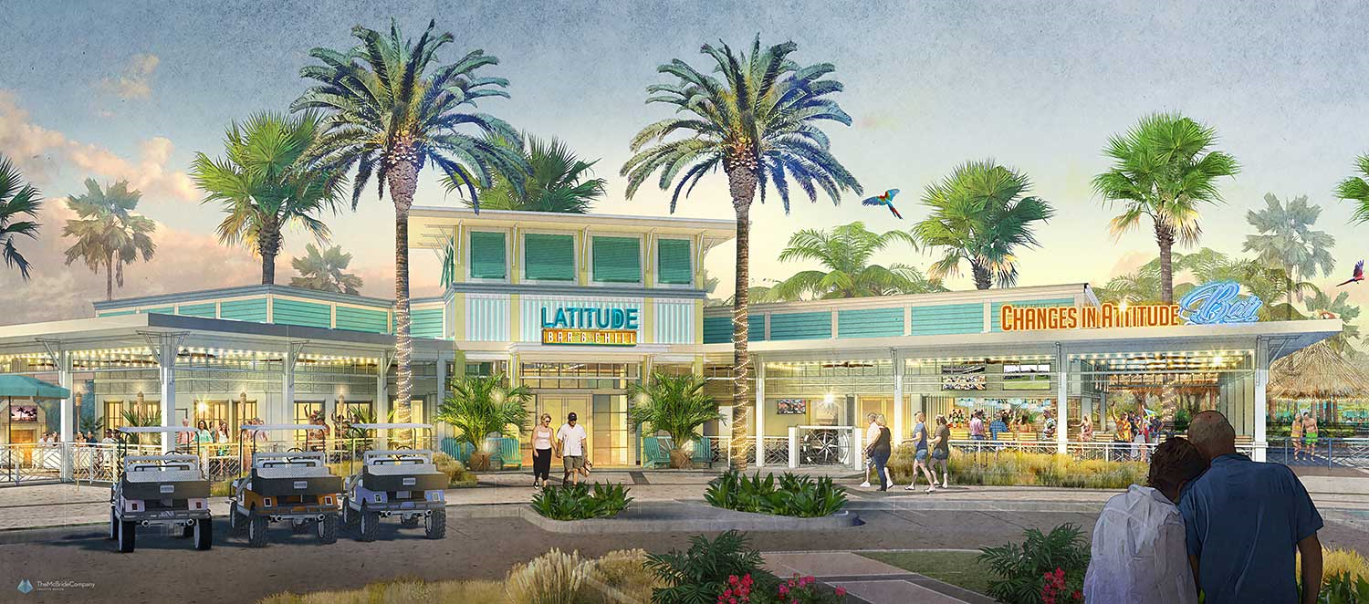
What Innovation Looks Like In 2017
Latitude Margaritaville, Daytona Beach, FL
Opened 2017 with campouts
Inspired by the legendary music & lifestyle of singer, songwriter & best-selling author Jimmy Buffett
Features exciting recreation, FINtastic dining and live entertainment
www.latitudemargaritaville.com

Slide 22
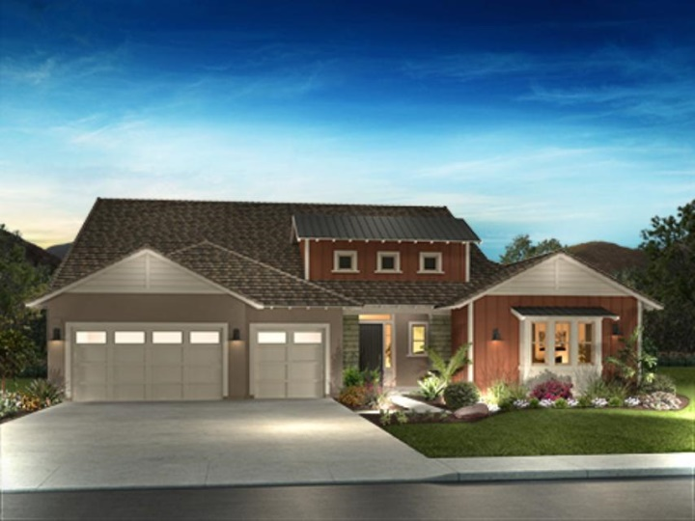

What Innovation Looks Like In 2017
Trilogy at the Vineyards in Brentwood, CA
34,000 sq. ft. resort club
Onsite vineyards
Signature restaurant & bar
Indoor Junior Olympic & outdoor resort pool
Culinary studio
Full-service, resort-caliber spa
1520 to 3111 sq. ft. plans
www.trilogylife.com

Slide 23
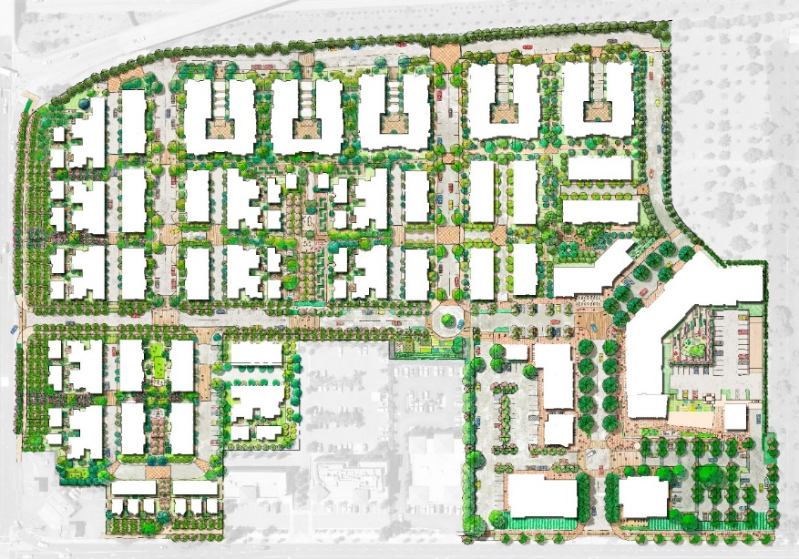
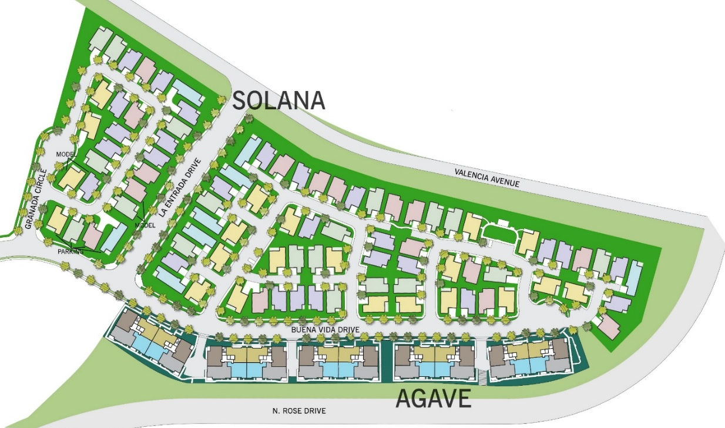
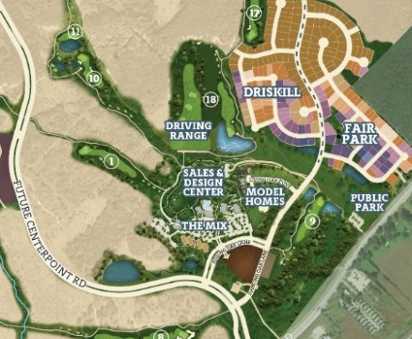
What Innovation Looks Like In 2020
Boomers, Millennials & Families
North 40: Mixed-use Infill Community
Kissing Tree: Integrated Masterplan Development
La Floresta: New Directions for +55 Developers

Slide 24



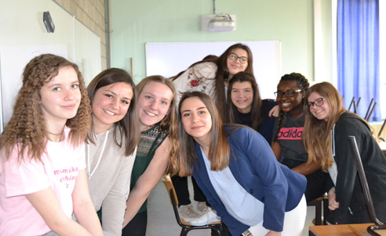
Generations
“Silent Generation” – born between 1939 – 1945
Lowest number of births due to WWII.
Welcomed technology into their lives (TV).
“Baby Boomers” – born 1946 – 1964
Faced a time of great prosperity and calm after WWII. Return of soldiers increased births exponentially. Hence the boom!
“Gen X” – born 1965 – 1979
Shaped by the oil and energy crisis. Saw the rise of home computers, video games, cable TV and the internet.
“Gen Y” - Millennials – born 1980 – 1994
Often culturally liberal points of view. They respect all heritages, cultures and beliefs – every person is important and unique.

Slide 25

Target Market
  “No brainer customer”
  Single-story or ranch style
  First floor Master Bedroom
  Condo flat
  The “lateral mover” – not downsizing, just getting what they want
  The “custom” customer – building it ground up!
  The “hider” customer – integrate into mixed fabric communities
  “Non-couple” customer
  Single women with power and $$
  Same gender buying together
  Multi-gen: grandparent (s) w/kids

Slide 26

Psychographics & Aging
  Psychographics
  As a group, this generation is characterized by a deep reaction to all forms of tradition – religious, familial, cultural, musical, societal.
Age in place – out of new home market
Instead of waiting for a health emergency before remodeling their homes to meet the challenge of aging, a growing number of Baby Boomers are pro-active.
Source: 55places.com – TDN.com

Slide 27

Cool Age-restricted Or Age-targeted Housing
1
  MPC with clubhouse and amenities
  MPC with a twist
  Urban alternatives
  Enclaves with no label
  Second home market
2
3
4
5

Slide 28
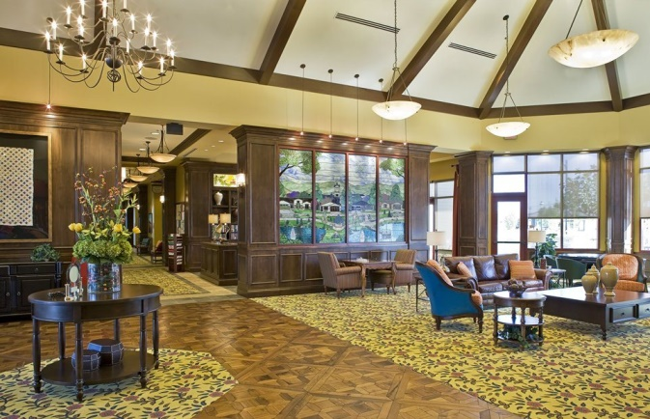
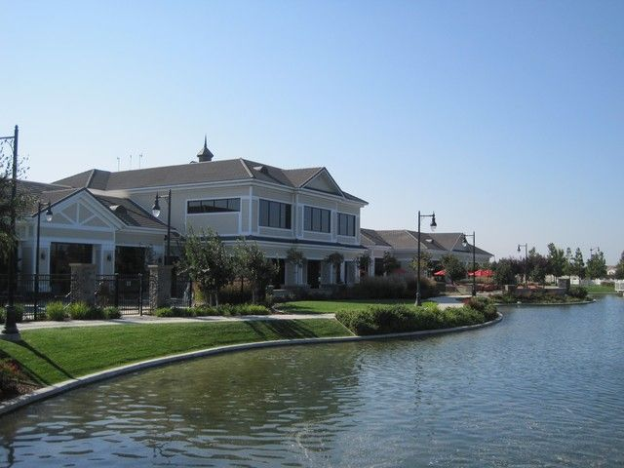
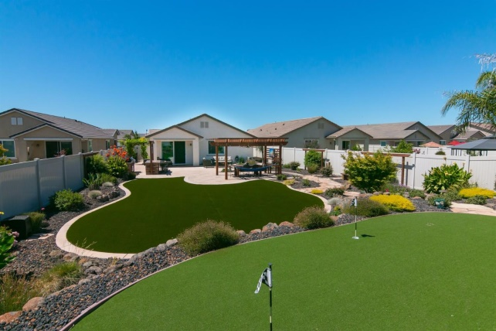
1
MPC With Clubhouse and Amenities “Meat & Potatoes”
Woodbridge - Manteca, CA
While this is fantastically successful, many Boomers want something different than the conventional, large scale retirement communities built in the past. They see these communities as my “parent’s retirement community”.
“It’s just not hip enough for me”.
www.DelWebb.com

Slide 29
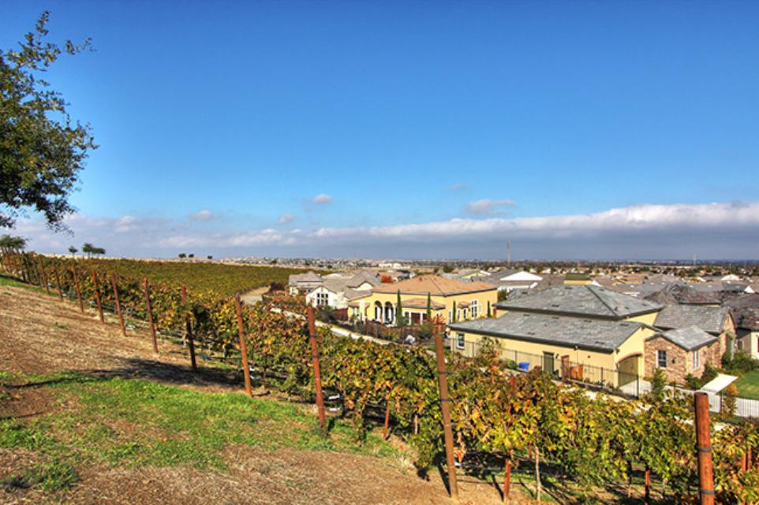
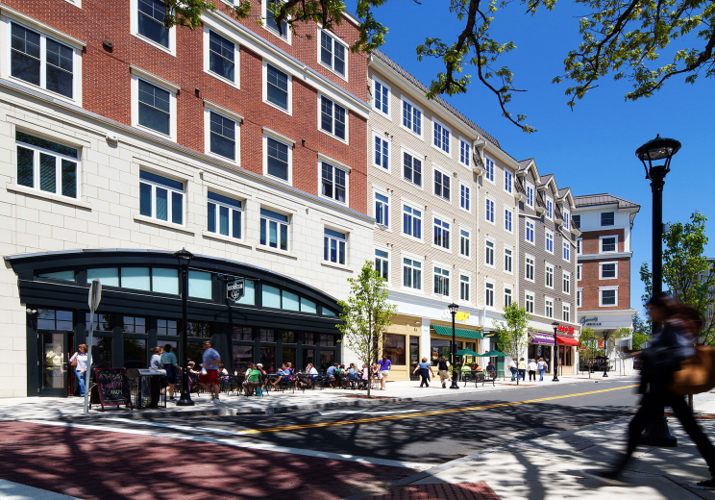
MPC With A Twist
2
Trilogy® at The Vineyards in Brentwood, CA
A spin of the typical MPC of the past! Life at Trilogy is about connecting - with the people they love, new passions they discover, and with new neighbors who share this rejuvenating time of life.
www.trilogylife.com
Storrs Town Center in Storrs, CT
This mixed-use town center, located adjacent to the University of Connecticut, has an eclectic mix of restaurants, shops, offices, homes, walkways, and green spaces. It creates a connected, thriving community for everyone in the region.
www.storrscenter.com

Slide 30
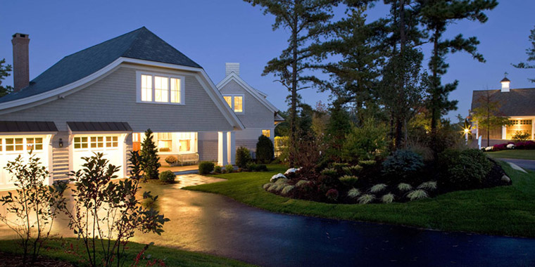
MPC With A Twist
2
The Pinehills in Plymouth, MA
Born over a decade ago, this well-established village is one of the nation’s most celebrated examples of thoughtful community planning and design.
Carefree townhomes; charming, cottages; spacious portfolio homes; one-of-a-kind custom homes & a neighborhood for the 55+.
Homes are grouped together in small, organic neighborhoods that conserve open space, trees and wildlife habitat while enhancing residents’ views and personal privacy.
www.pinehills.com

Slide 31

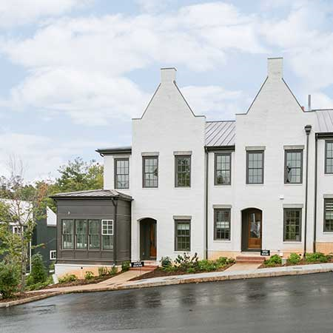
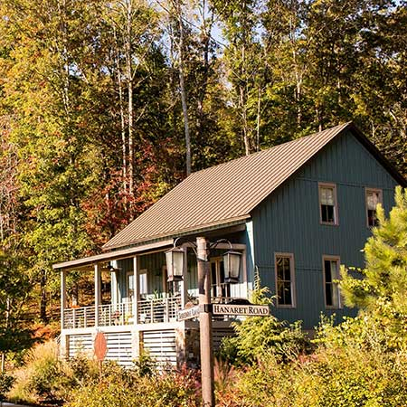
MPC With A Twist
2
Serenbe in Chattahoochee Hills, GA
Serenbe is a progressive community connected to nature and is reminiscent of communities of yesteryear, when life was simpler.
Each of the four hamlets have complementary commercial centers.
Townhouses, cottages, lofts, and estate homes for all lifestyles can be found at Serenbe.
“The best reason to live here is the life here.”
“Serenbe is a utopian experiment in New Urbanism being molded out of Georgia red clay.”
-New York Times
www.serenbe.com

Slide 32




Notes:
Target Market 65 -75

Slide 33
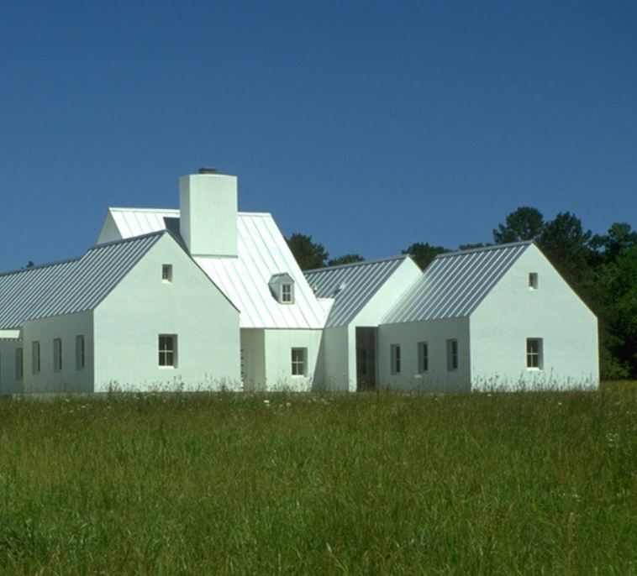
Urban Farmhouse
Notes:
Modern Farmhouse architectural style is a strong trend nationwide

Slide 34
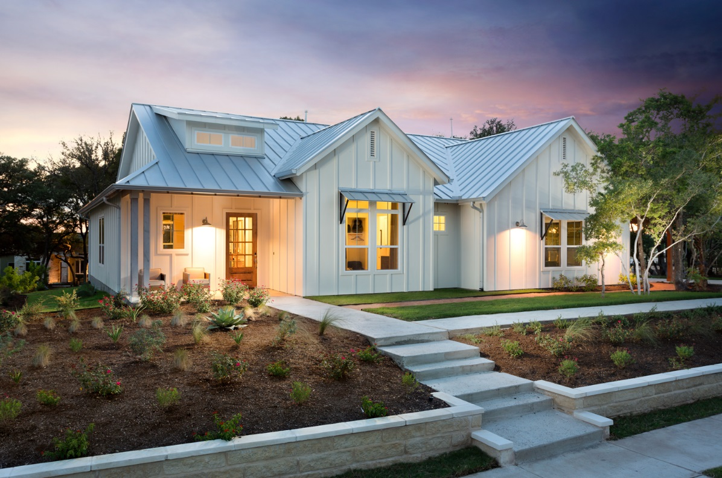
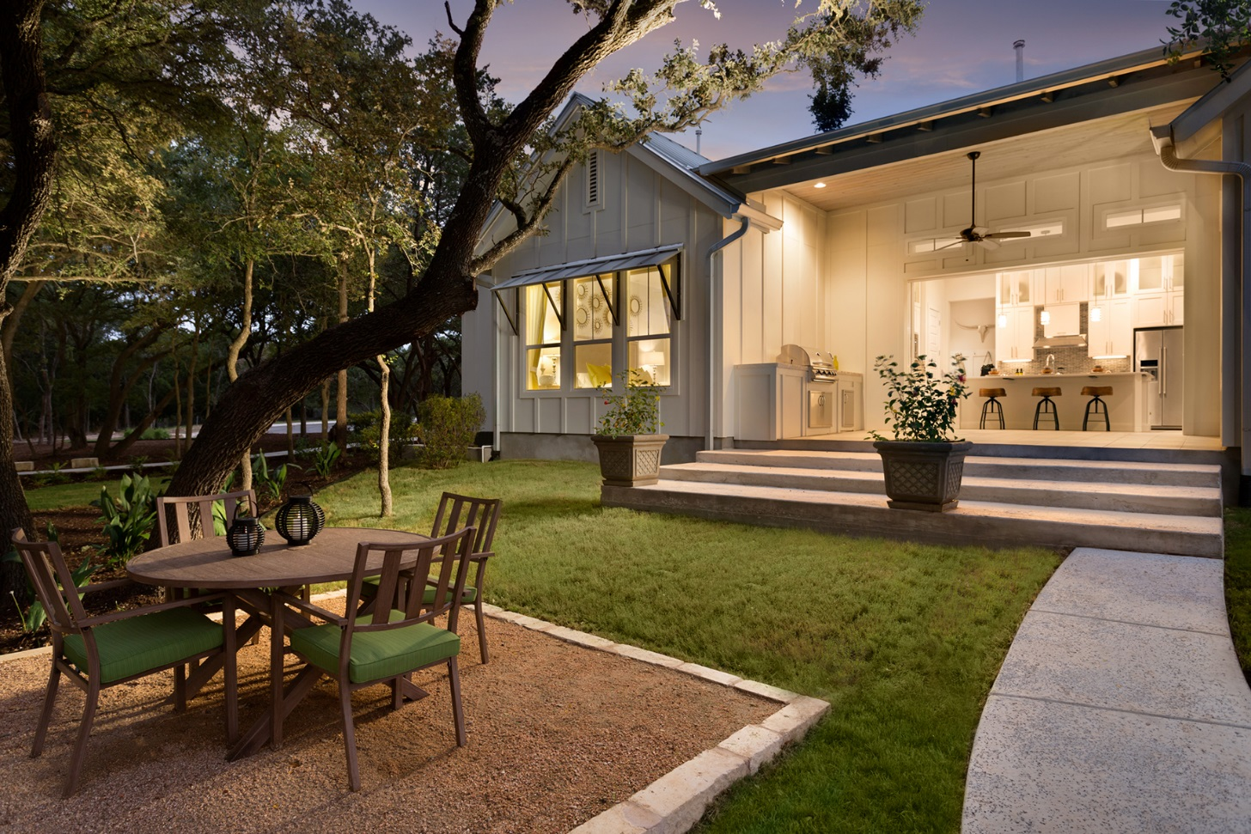
Notes:
Blanco Vista, San Marcos, TX

Slide 35
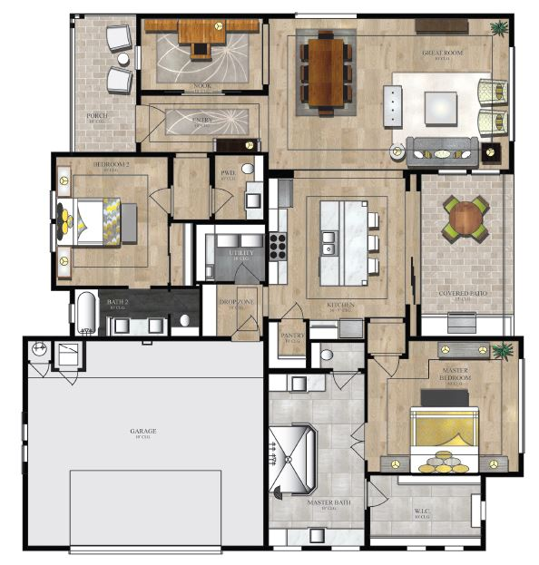
2,257 sq. ft.
Notes:
Efficient plan with lots of bells and whistles –
telescoping doors that open up the home to wonderful outdoor living
Huge master bath with walk-in shower
Pocket study at entry

Slide 36
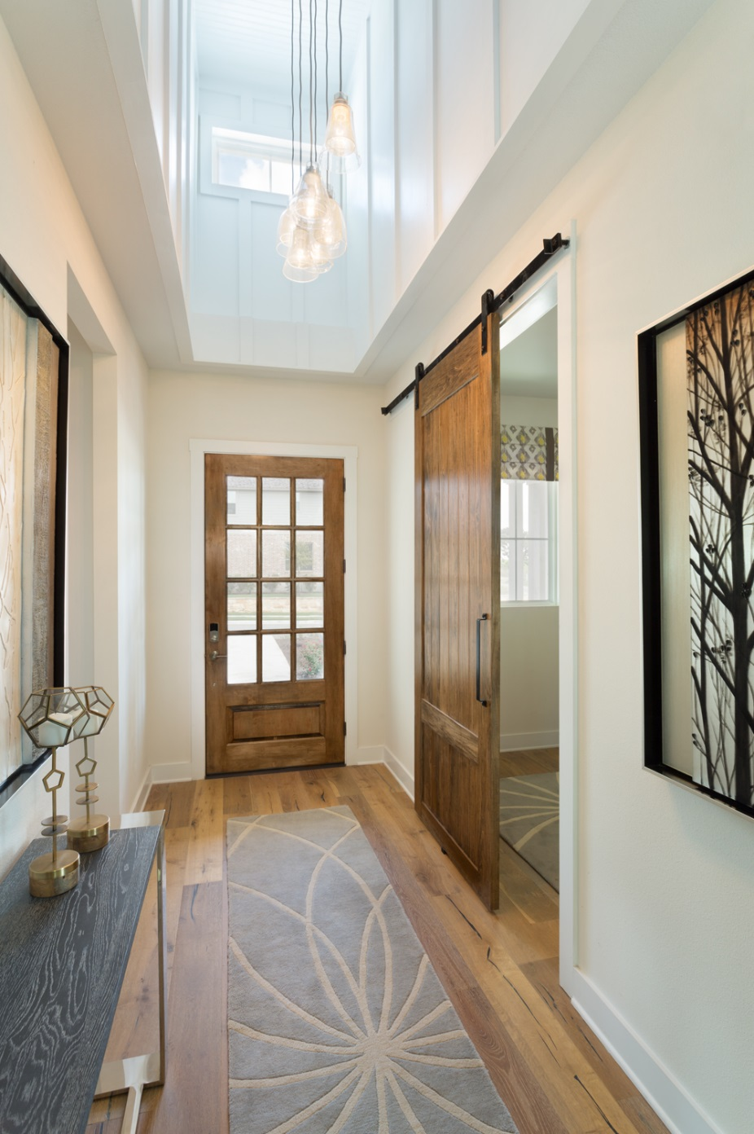
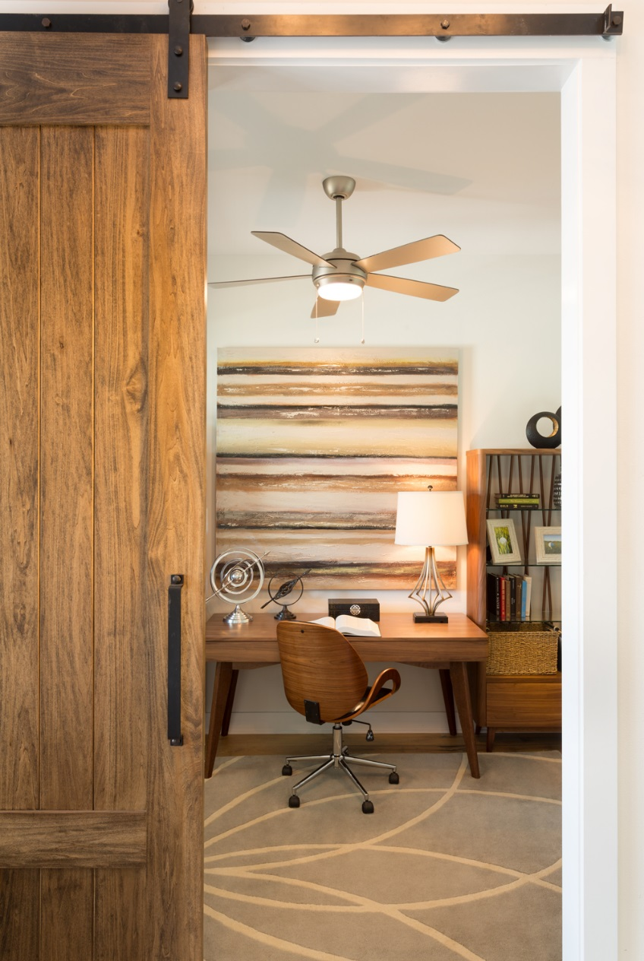
Notes:
Foyer with pocket study and barn door – white oak wide plank flooring. Pop-up ceiling with skylight, board and batten and multi-tiered light fixture
Hard surface flooring throughout

Slide 37
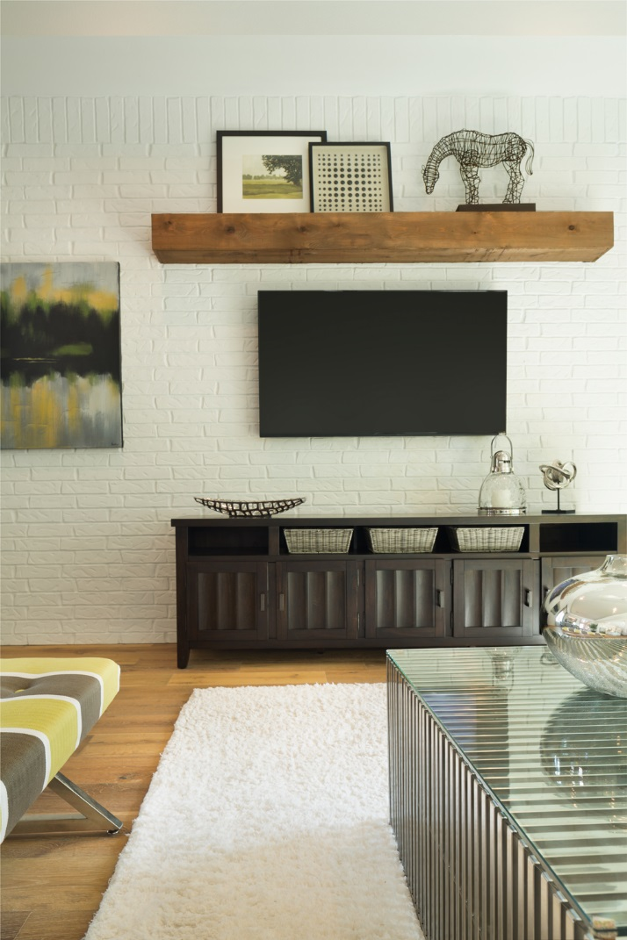
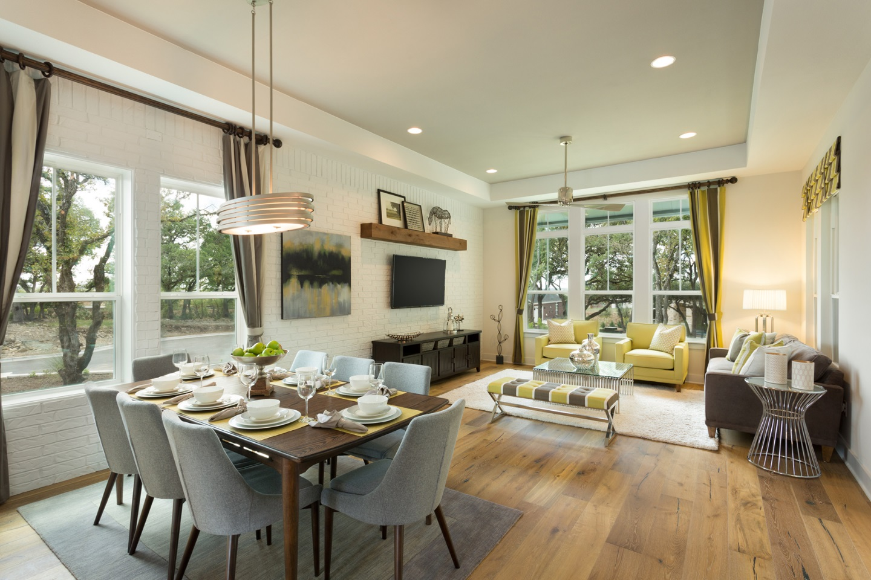
Notes:
Wide open floor plan – painted brick wall

Slide 38
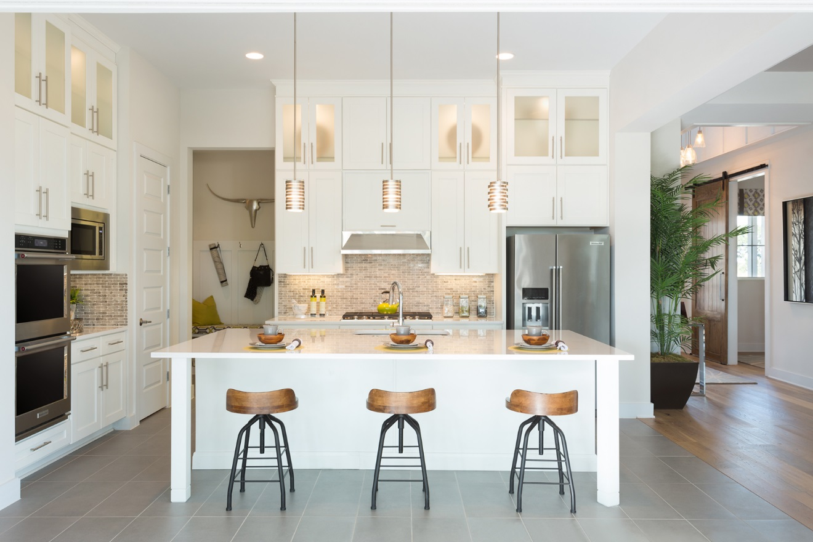
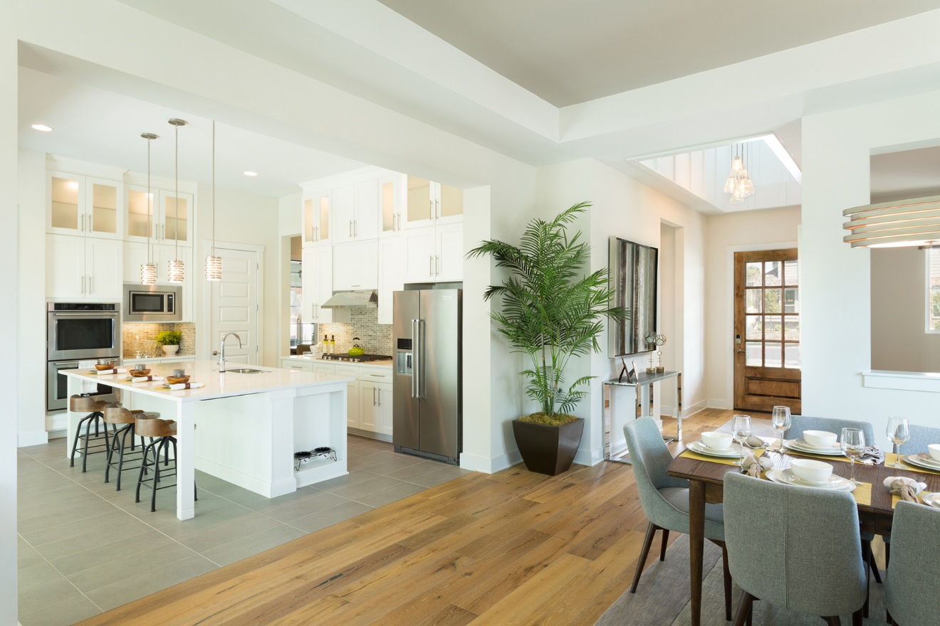
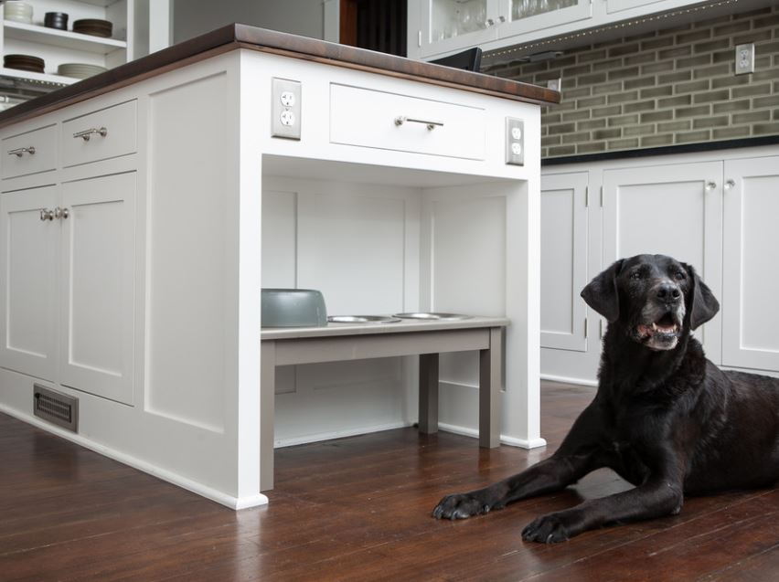
Notes:
Gourmet kitchen with a raised dogfood caddy

Slide 39
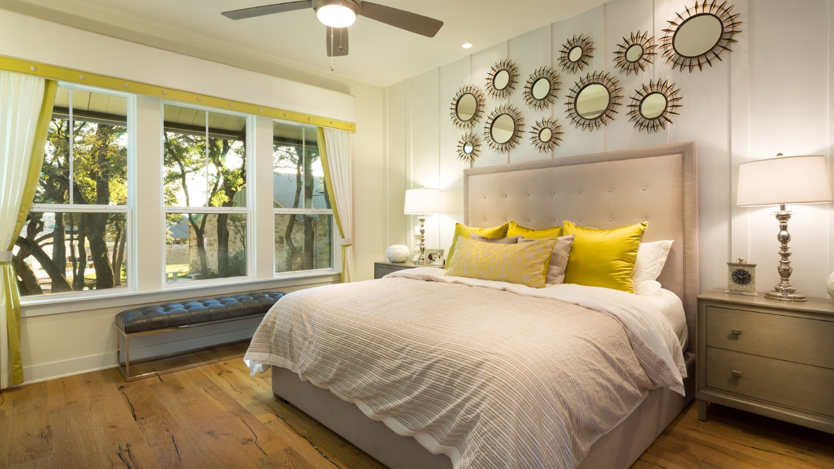
Notes:
Master bedroom with simple batten on bed wall

Slide 40
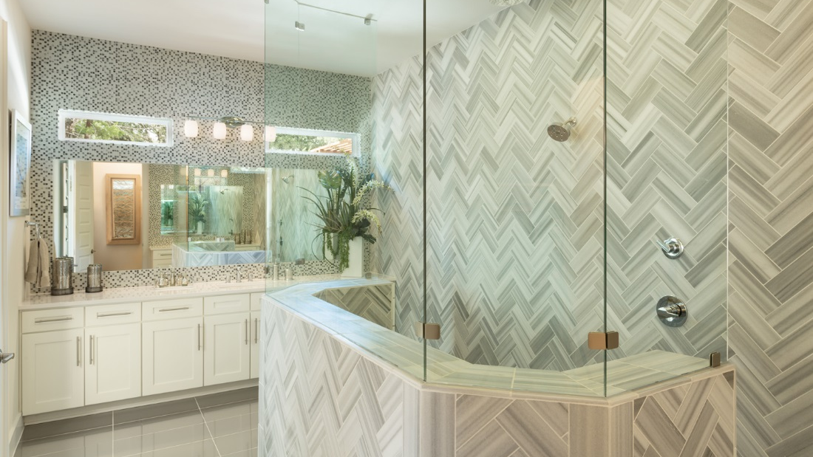
Notes:
Master bath with huge walk-in shower

Slide 41

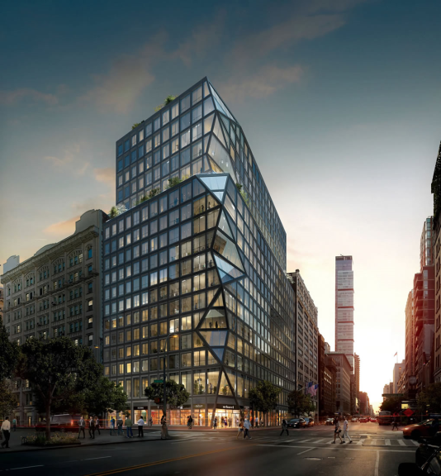
Urban Alternatives – New York
3
Many mature buyers prefer to downsize and remain in the city, or they return to the urban core to get away from the car-choked burbs and to be able to walk to services and amenities.
Living in a vibrant downtown affords opportunities to enjoy year-round activities and events, in many areas this is considered high-end independent living.
121 E 22ND by Toll Brothers City Living
For those elite buyers with $$$, 121 E 22ND offers 67 unique floor plans on 18 floors giving each condominium residence something unique.
www.121e22nd.com

Slide 42

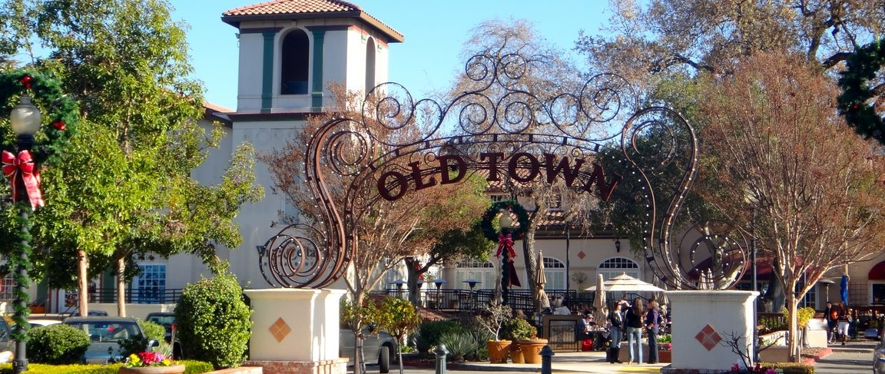
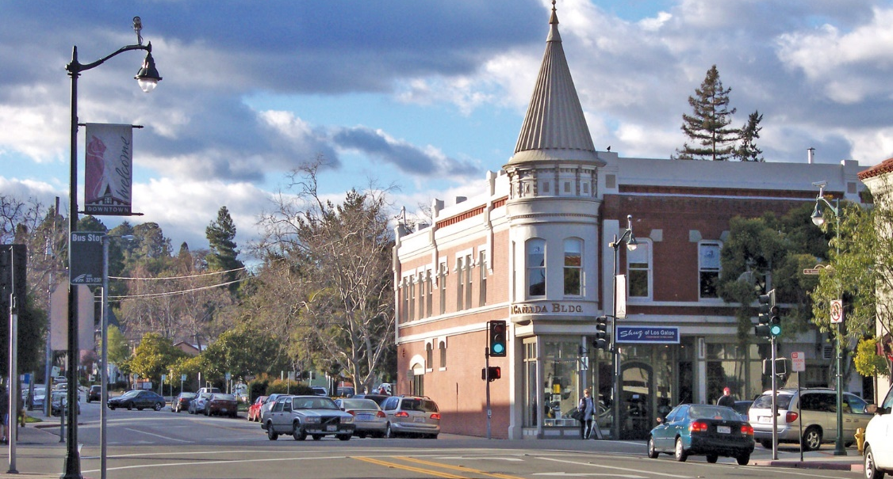
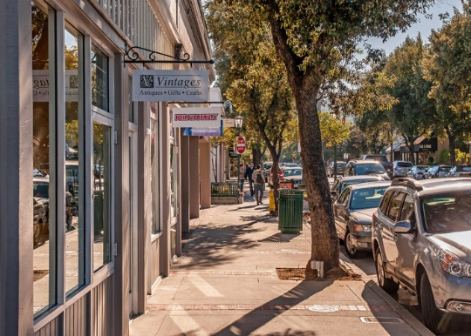
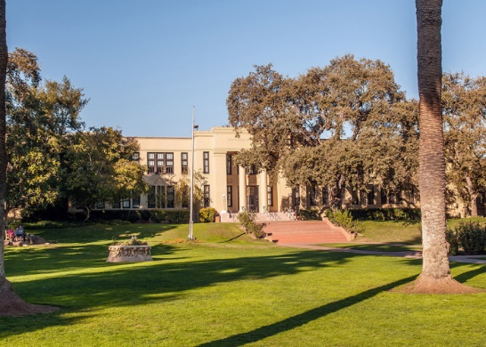
North 40 – Town Of Los Gatos
Infill Development / Staying in Your Community
www.losgatosnorth40.com
Build In Amenities

Slide 43

North 40 – Commercial And Park/Gardens
www.losgatosnorth40.com
The Commons
Marketplace
Restaurants and Specialties
Key senior mkt plan features
The Commons – Gardens and Gathering Central

Slide 44



North 40 – Garden Cluster
Contemporary Architecture
Bold, Fresh
Key senior mkt plan features
www.losgatosnorth40.com
Design for all Generations
Energy, Natural Light

Slide 45


North 40 – Garden Cluster – Flat Plan
Key senior mkt plan features
Resort Influenced Open Plans
Clean, Contemporary Interiors
Luxurious Showers And Baths
www.losgatosnorth40.com

Slide 46

North 40 – Townhome Cluster
Unique Distinctive Character
Well Articulated Forms – Pedestrian Quality
Four Sided Architecture
Key senior mkt plan features
www.losgatosnorth40.com

Slide 47


North 40 – Townhome Cluster – Flat Plan
Unique Distinctive Character
Well Articulated Forms – Pedestrian Quality
Four Sided Architecture
Key senior mkt plan features
www.losgatosnorth40.com

Slide 48


North 40 – Unique Interiors
Key senior mkt plan features
Elegant, Light, Airy and Energetic
Contemporary Interiors
Key senior mkt plan features
www.losgatosnorth40.com

Slide 49



Enclaves With No Label
4
Warwick Grove, Warwick, NY
This 240 unit mixed-use traditional neighborhood with an award-winning housing design, recalls the past while providing amenities of modern living.
www.warwick-grove.com
Cottages on Greene, East Greenwich, RI
Fifteen units of mixed-income condominiums organized into a compact cottage court development.
www.unionstudioarch.com
Concord Riverwalk, Concord, MA
A compact “pocket neighborhood” of 13 Net Zero possible homes.
www.concordriverwalk.com

Slide 50



Modern Hill Country
Notes:
Native Texas stone

Slide 51

3,423 sq. ft.
Notes:
The entertainers

Slide 52


Notes:
This large utility room is accessible through a master closet. We had plenty of room to create a craft space increasing the value of the room. Attractive, ambient lighting is important

Slide 53

Notes:
Ambient and task lighting are an important feature for this mark
Formal and informal living areas are appealing for entertaining large groups of people as well as for giving occupants some personal spaces

Slide 54

Notes:
Glamorous master bedroom - Hard surface flooring throughout – small details like trim and accent paint are affordable ways to bring a room to life

Slide 55


Notes:
Large mirrors help to brighten the bath – tub inside the shower is a trend better left to other markets – too difficult to maintain

Slide 56


Second Home Market
5
Heritage Sands, Dennisport, MA
Life at Heritage Sands is what “Your place on the Cape” has meant to families for generations. A second home … Summer gatherings and weekend escapes with friends and family.
www.heritagesands.com
Tahoe Beach Club, Lake Tahoe, NV
143 condominiums meld modern livability with the timelessness of Tahoe with amenities of a luxury resort on a private sand beach. It is the first lakefront residential community approved on the lake in more than 30 years.
2 to 5 bedroom residences priced from $1.3 to $4.5 million.
www.thetahoebeachclub.com

Slide 57


Second Home Market
5
Legacy Home
In-Town Condo

Slide 58







Esencia At Rancho Mission Viejo
Intertwining the Generations
Casual Community Amenities
Generation Connections
Connections to Nature
Resort Quality
Resort Quality
www.ranchomissionviejo.com

Slide 59

La Floresta Multigenerational Community
Infill Neighborhood
Shopping /
Restaurants, Walkable
Stay In Your Community
A Place For All Ages
www.laflorestabrea.com

Slide 60






La Floresta Community
www.laflorestabrea.com
Healthy Choices
Friends
Family Possibilities

Slide 61

La Floresta Community
Livable Density
Pedestrian Scale
Connected Community
www.laflorestabrea.com

Slide 62


Solana At La Floresta – Prado Plan
1,485 sqft total | 2/3 Bedroom / 2 Bath, Open plan, 2-car Garage
First Floor
Open Entertaining Plan
Flex Room Possibilities
Accessibility And Walk-in Showers
www.laflorestabrea.com

Slide 63




www.laflorestabrea.com
Courtyard Living
Kitchen Entertaining
Third Flexible Bedroom
Comfortable Baths

Slide 64



Solana At La Floresta – Seville Plan
1,715 sqft total | 2 Bedroom / 2 1/2 Bath, Open plan, 2-car Garage
www.laflorestabrea.com
Second Floor
First Floor

Slide 65

Agave At La Floresta
www.laflorestabrea.com
Single Family Living 33 Units To The Acre

Slide 66


Agave At La Floresta
First Floor / Garage Plan/16 Units
www.laflorestabrea.com

Slide 67

1,565 sqft total | 3 Bedroom / 2 Bath, Open plan, 2-car Garage
Great Room
Kitchen Centerpieces
Den Possibilities
Large Roll-in Shower Room Size Terraces
www.laflorestabrea.com

Slide 68
Kitchen Trends For The 55+ Buyer
More than just for cooking
Open to the rest of the house
Ease of use for all
Connectivity
“Modern” designs
Quartz will be the preferred surface
Notes:
Demonstating options –
‘art
Demonstrating options – “art” on right is a smile provoking narrative – Pets are People too!

Slide 69

Notes:
Kitchens – the most important room in the house?
Ambient and task lighting
Two tier island

Slide 70

Notes:
Kitchens – the most important room in the house?
According to an NAHB 55+ consumer surney 73% preferred a kitchen/family room that was completely open or visually open

Slide 71


Slide 72
Bath Trends For The 55+ Buyer
Walk-in Showers In Lieu of Tubs
Shades Of White and Gray
Integrated Safety Features
Lots of Storage
Split Vanities

Slide 73

Notes:
Kitchens – the most important room in the house?

Slide 74


Slide 75
NOT THE SAME 55+ Active, Eclectic, Family
Second Home Market
MPC With a Twist
Enclaves With No Label
MPC With Clubhouse and Amenities
Urban Alternatives

Slide 77
John Thatch
Dahlin Group Architecture Planning
john.thatch@dahlingroup.com
Mary DeWalt
Mary DeWalt
Design Group
mary@marydewaltdesigngroup.com
Debra Bernard
The Bernard
Partnership
Dbernard@bernardpartnership.com

Slide 79
Baby Boomer Trends
Healthier, wealthier, and with plans to work into their 70’s, they intend to live life with gusto. They see themselves as emotional & social centers of their families
They want a homestead that can both accommodate family gatherings & adapt to their changing physical abilities
They are throwing a wrench into the retirement housing market. Rejecting cookie-cutter retirement communities & condominiums of days past, they are looking for new forms of affinity living & aging-in-place strategies
Jewel Box Homes – full amenity homes built on a smaller scale (23%), confined to a single story. Downsizing is proving to be an upscale activity
44% of Boomers who move or consider moving from their old Empty Nest want a house that requires less maintenance (62%). Maintenance will be a paramount issue in choosing a home
Source: EscapeHomes.com, www.agelessons.com

